Slide 1

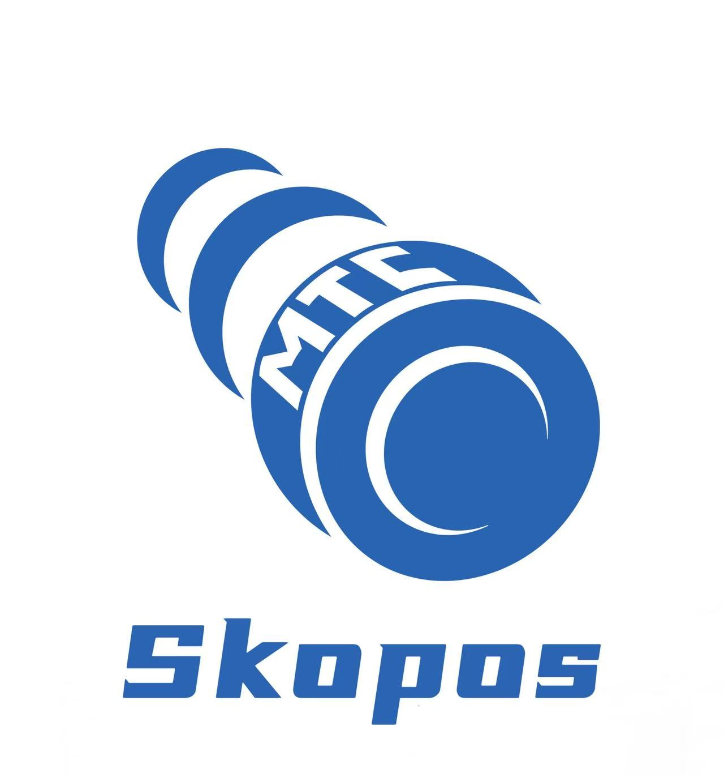
AI Role Designer
From Functional Blueprint to
SoD-Free Roles in Weeks
Combine human judgment with AI orchestration to redesign SAP roles
in a fraction of the traditional timeline.

Slide 2





Traditional Role Redesign: A 4-Phase Marathon
11-22 weeks minimum, with each iteration costing days
Discovery
Design
Validation
Build
2-4 wks
3-6 wks
2-4 wks
4-8 wks
Business process interviews, functional documentation
Role mapping with transaction usage analysis
SoD conflict simulation and remediation
PFCG role creation and user assignment
"The bottleneck isn't knowledge. It's iteration speed."
Advanced Access Risk Analysis and Remediation for ERP Systems built for the AI era
Join forward-thinking companies using MTC Skopos for comprehensive access risk

Slide 3



How the AI Role Designer Works
Seven-step workflow combining human judgment with AI orchestration
Steps 1-2
Steps 3-5
Steps 6-7
Connect & Configure
Generate & Simulate
Iterate & Export
Connect AI to MTC Skopos via MCP
Provide functional design template
Load actual system data
AI generates role concepts from usage data
Simulate SAP role tables (AGR_*)
Run full SoD risk analysis & remediation
Iterate until business satisfaction
Export for PFCG build or automate
Validate completeness
Advanced Access Risk Analysis and Remediation for ERP Systems built for the AI era
Join forward-thinking companies using MTC Skopos for comprehensive access risk

Slide 4



What's Under the Hood
A specialized agent pipeline, not generic AI assistance
Role Redesign Agent
Orchestrator: produces user-role matrix, single role design, stakeholder presentations
Rebuild Simulation
Generates realistic SAP role tables with full authorization object/field/value data
SoD Root Cause
Classifies remaining risks by remediation type: self-conflicting or separable
SoD-Free Design
Systematically eliminates separable conflicts through domain-specific splits
Completeness Check
Maps users to composites, detects gaps, validates 100% transaction coverage
Advanced Access Risk Analysis and Remediation for ERP Systems built for the AI era
Join forward-thinking companies using MTC Skopos for comprehensive access risk

Slide 5
The Iteration Loop: Why Speed Matters
Faster iterations enable better designs, not just faster delivery
10-15
2-3
minutes per AI-powered iteration
days per manual consulting iteration
✓ More rigorous quality assurance through rapid iteration
✓ Test multiple design alternatives within the same timeline
✓ Cross-domain access validation at every step
✓ Superior outcomes without extending project timelines
Advanced Access Risk Analysis and Remediation for ERP Systems built for the AI era
Join forward-thinking companies using MTC Skopos for comprehensive access risk

Slide 6



What Stays Human
Strategic decisions remain with people, not algorithms
Functional Design Decisions
Risk Appetite Judgments
Organizational structure, task mapping, and business process ownership
When to accept residual risk vs. when to restructure
Business Validation
Change Management
Confirm completeness, verify operational requirements are met
User communication, training, and organizational readiness
Advanced Access Risk Analysis and Remediation for ERP Systems built for the AI era
Join forward-thinking companies using MTC Skopos for comprehensive access risk

Slide 7


Technical Architecture
Simple three-component system with MCP orchestration
AI Client
MTC Skopos MCP
Claude / Claude Code
Risk Analysis Engine
Orchestrates the entire workflow using specialized agents
Provides risk analysis, usage data, simulation engine via MCP
Connected via Model Context Protocol (MCP)
Advanced Access Risk Analysis and Remediation for ERP Systems built for the AI era
Join forward-thinking companies using MTC Skopos for comprehensive access risk

Slide 8

Worked Example: 3,500 Users, 12 Departments
From 7,200+ SoD conflicts to zero in 3 weeks
Week 1
Week 2
Week 3
Functional design template populated
580+ transactions classified across 12 profiles
93 zero-usage transactions flagged for removal
120+ core single roles + 28 addon roles
High/Critical conflicts: 2,100 → 34
Second simulation: only 8 remain
3,460 of 3,500 users at 100% coverage
Edge cases resolved, stakeholder sign-off
Final: zero High/Critical SoD conflicts
Advanced Access Risk Analysis and Remediation for ERP Systems built for the AI era
Join forward-thinking companies using MTC Skopos for comprehensive access risk

Slide 9
The Results
Measurable outcomes from AI-assisted role redesign
3,500
7,200+
3 wks
Users Redesigned
Conflicts Resolved
Total Timeline
12 departments, full coverage
From 7,200+ to zero High/Critical
vs. 3-6 months traditional
Advanced Access Risk Analysis and Remediation for ERP Systems built for the AI era
Join forward-thinking companies using MTC Skopos for comprehensive access risk

Slide 10

Getting Started
Three things you need to begin your AI-assisted role redesign
1
2
3
MTC Skopos with SAP Data
MCP-Compatible AI Client
Functional Design Template
Download the portable application and load your SAP authorization data. No servers, no installation required.
Claude Code, Claude Desktop, or any MCP-compatible client to orchestrate the redesign workflow.
Business owners provide the functional blueprint: org structure, task assignments, process ownership.
Advanced Access Risk Analysis and Remediation for ERP Systems built for the AI era
Join forward-thinking companies using MTC Skopos for comprehensive access risk

Slide 11
Ready to Redesign
Your SAP Roles?
Start your free 14-day trial. Load SAP data, connect MCP,
and orchestrate AI-assisted role redesign in weeks, not months.
mtcskopos.com • info@meylan-tc.com • Meylan Technologies & Consulting, Geneva
Advanced Access Risk Analysis and Remediation for ERP Systems built for the AI era
Join forward-thinking companies using MTC Skopos for comprehensive access risk

