Slide 1

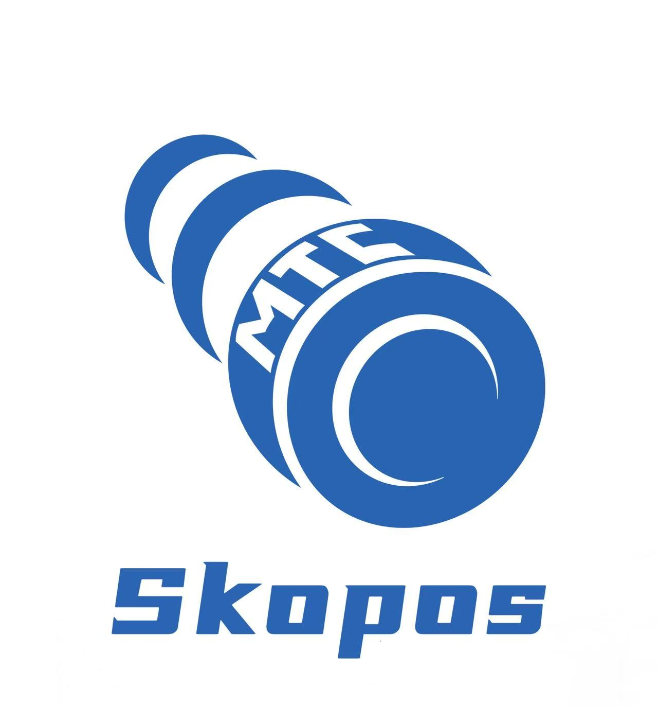
Segregation of Duties Software
for SAP & ERP Systems
The fast, portable SoD tool for Segregation of Duties analysis, Critical Access detection, and automated remediation across SAP and any ERP.

Slide 2



Fast, Smooth and Affordable Access Governance
Traditional GRC tools are slow and complex
Changes introduce new risks
Remediation is guesswork
Servers, consultants, months of setup and still, running a full SoD analysis takes hours or days.
Every role modification or user provisioning can create new SoD conflicts. Without simulation, you only find out after the fact.
Knowing you have conflicts is one thing. Knowing which changes won't break business operations is another.
→ Download, connect, analyze in minutes. No infrastructure.
→ Simulate changes before applying them. See risk impact instantly.
→ Get step-by-step remediation plans ranked by business impact.
Advanced Access Risk Analysis and Remediation for ERP Systems built for the AI era
Join forward-thinking companies using MTC Skopos for comprehensive access risk

Slide 3
Automated SoD Analysis in 3 Simple Steps
From download to comprehensive risk remediation in minutes, not months
1
2
3
Download & Run
Connect Your Data
Analyze & Remediate
▶
▶
Get the lightweight portable application. No servers, no complex setup, no installation, no IT project required.
Import via SAP RFC connection or CSV export from any ERP system. Your data stays on your machine.
Get instant SoD analysis, identify violations, and receive actionable remediation recommendations.
Advanced Access Risk Analysis and Remediation for ERP Systems built for the AI era
Join forward-thinking companies using MTC Skopos for comprehensive access risk

Slide 4
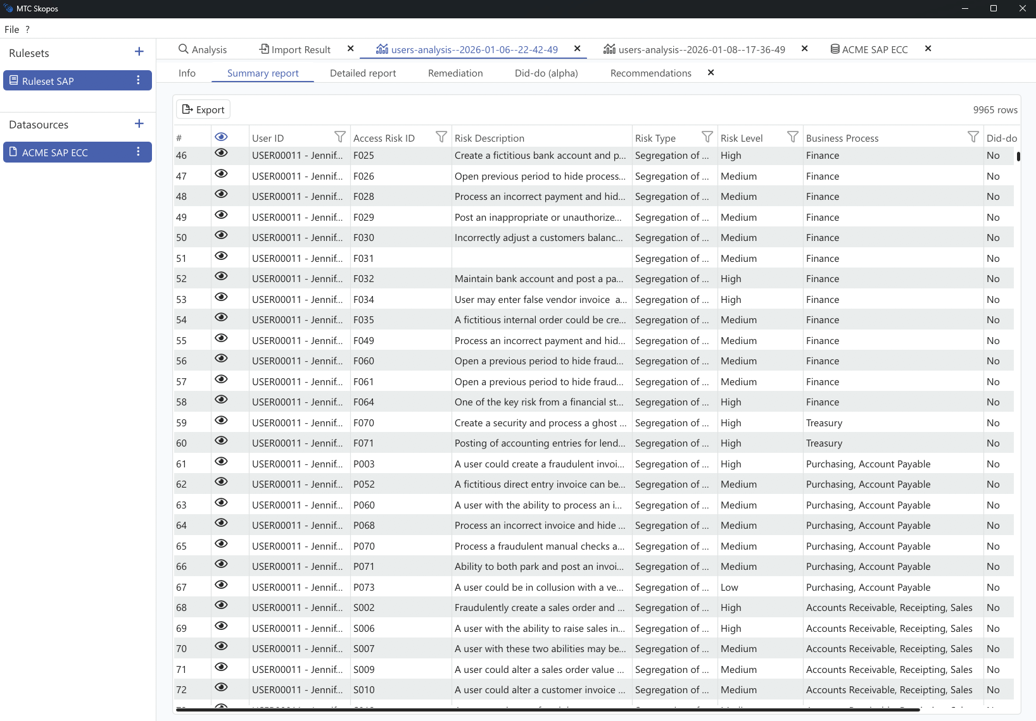
Comprehensive Risk Analysis
See your entire risk landscape with SoD and Critical Access analysis across users, roles, and systems.
Knowing who has access to what isn't just best practice: it's your competitive advantage.
✓ User & Role-level SoD analysis
✓ Cross-system risk detection
✓ Interactive user & role explorer
✓ Excel-based ruleset maintenance
Advanced Access Risk Analysis and Remediation for ERP Systems built for the AI era
Join forward-thinking companies using MTC Skopos for comprehensive access risk

Slide 5
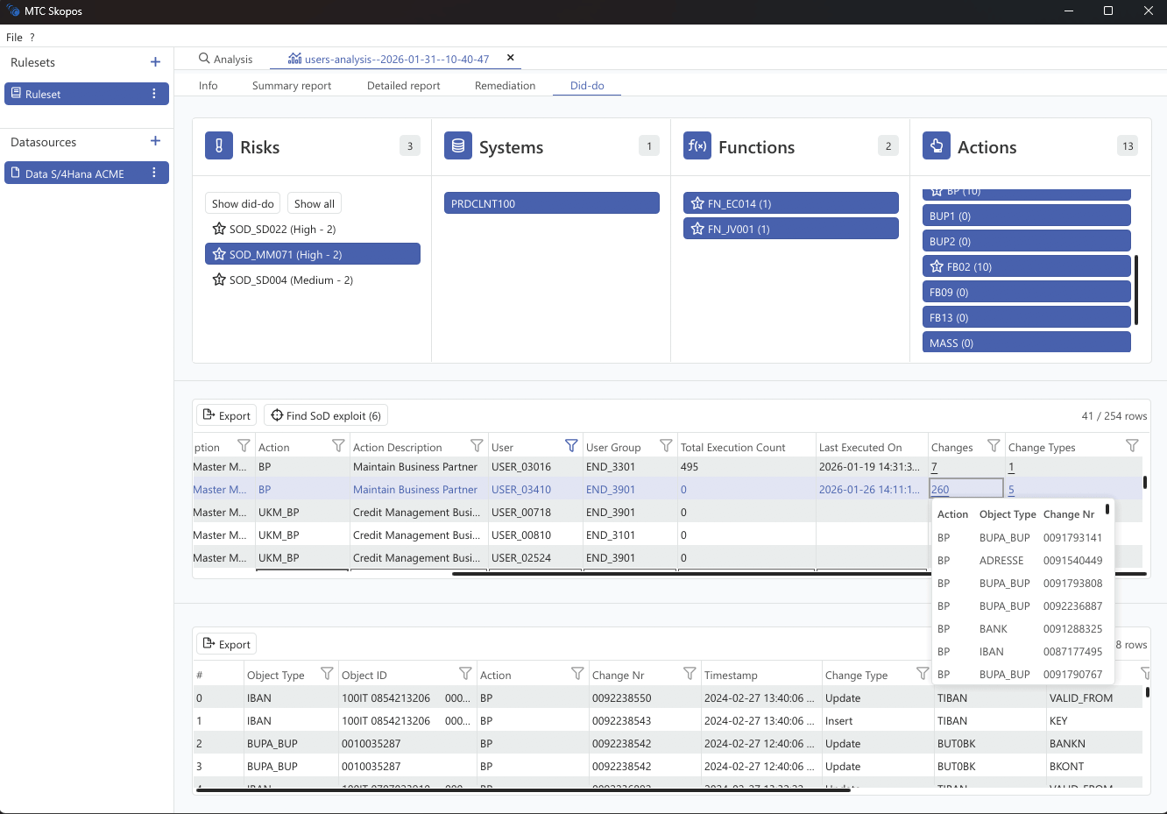
Did-Do Analysis: Real Risks, Not Theoretical
SAP GRC tells you who could exploit a conflict. MTC Skopos tells you who actually did.
Traditional "can-do" analysis produces thousands of violations. Our "did-do" analysis cross-references access with actual transaction execution, so you focus on risks that materialized.
✓ Correlate SoD violations with change documents
✓ Distinguish execution counts from actual changes
✓ Prioritize remediation on materialized risks
✓ Evidence-based audit reporting
Advanced Access Risk Analysis and Remediation for ERP Systems built for the AI era
Join forward-thinking companies using MTC Skopos for comprehensive access risk

Slide 6
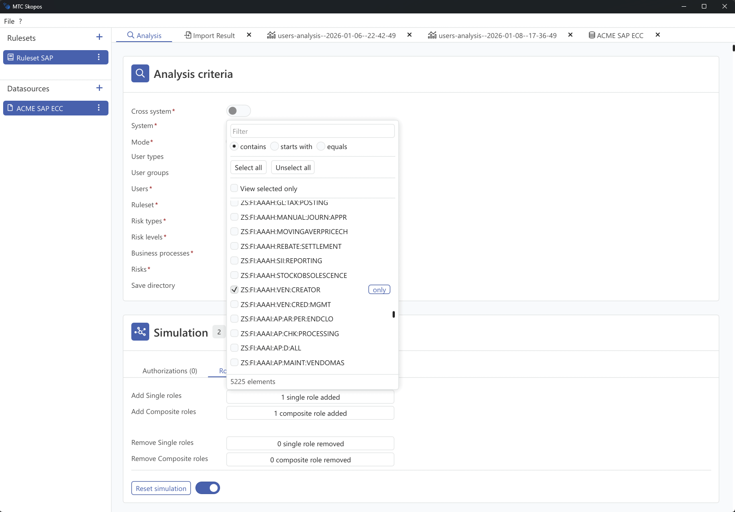
Risk Simulation
Test before you deploy. Simulate user provisioning and role changes to see risk impact before applying them.
Prevention during design isn't just efficient: it's strategic architecture.
✓ User provisioning simulation
✓ Role modification impact analysis
✓ Predictive risk modeling
✓ What-if scenario testing
Advanced Access Risk Analysis and Remediation for ERP Systems built for the AI era
Join forward-thinking companies using MTC Skopos for comprehensive access risk

Slide 7
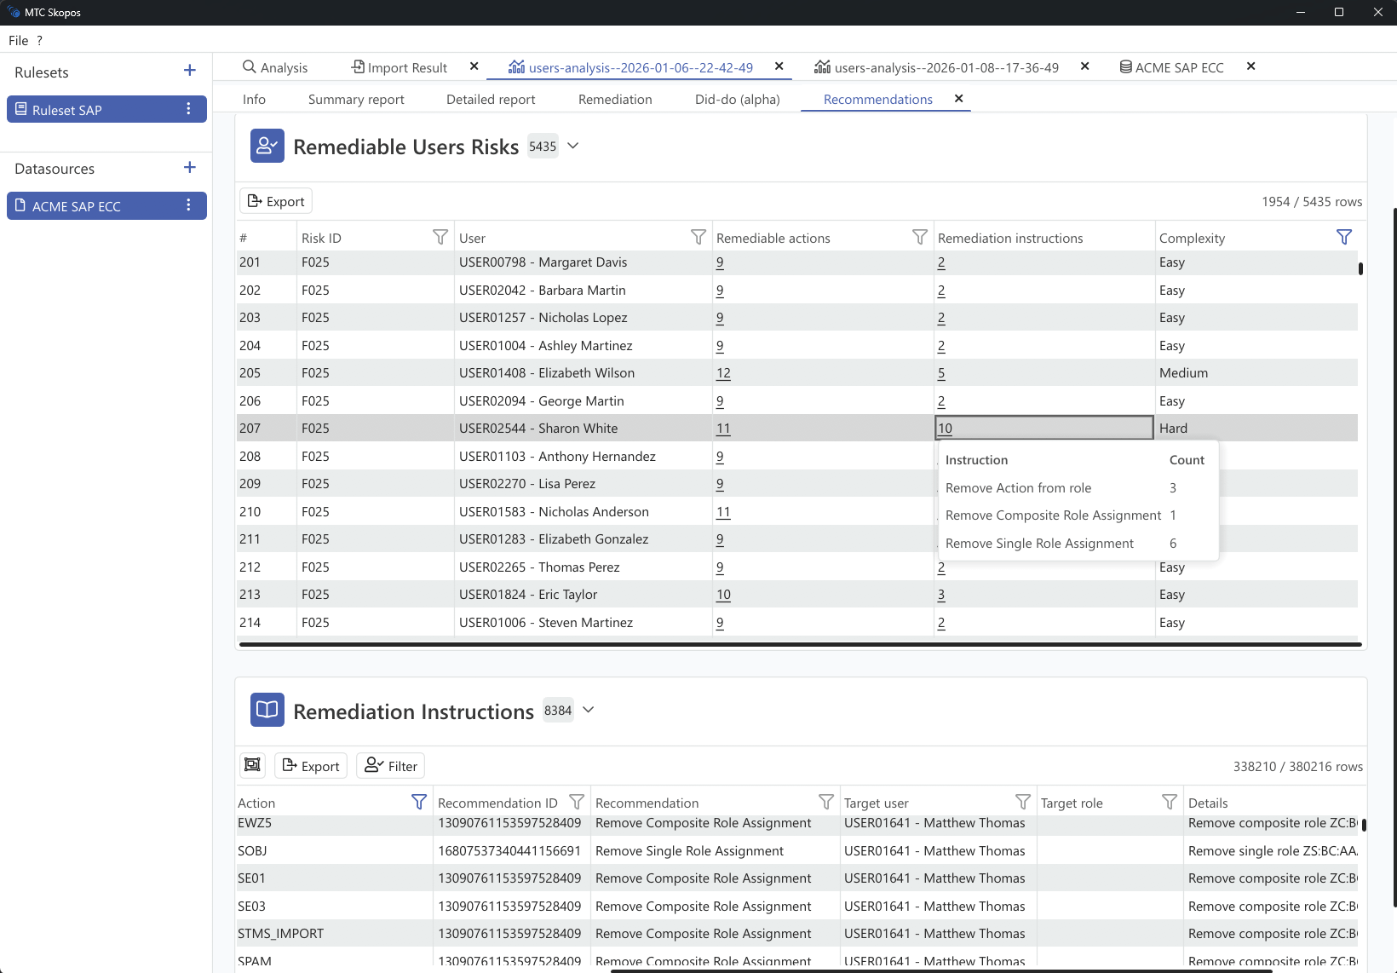
Intelligent Remediation
Fix risks without breaking business. Our algorithm recommends the least disruptive changes first, with detailed action plans.
Stop guessing which changes won't break anything: let the engine figure it out.
✓ 4-phase remediation algorithm
✓ Usage-based recommendations
✓ Step-by-step action plans
✓ Impact analysis before changes
Advanced Access Risk Analysis and Remediation for ERP Systems built for the AI era
Join forward-thinking companies using MTC Skopos for comprehensive access risk

Slide 8
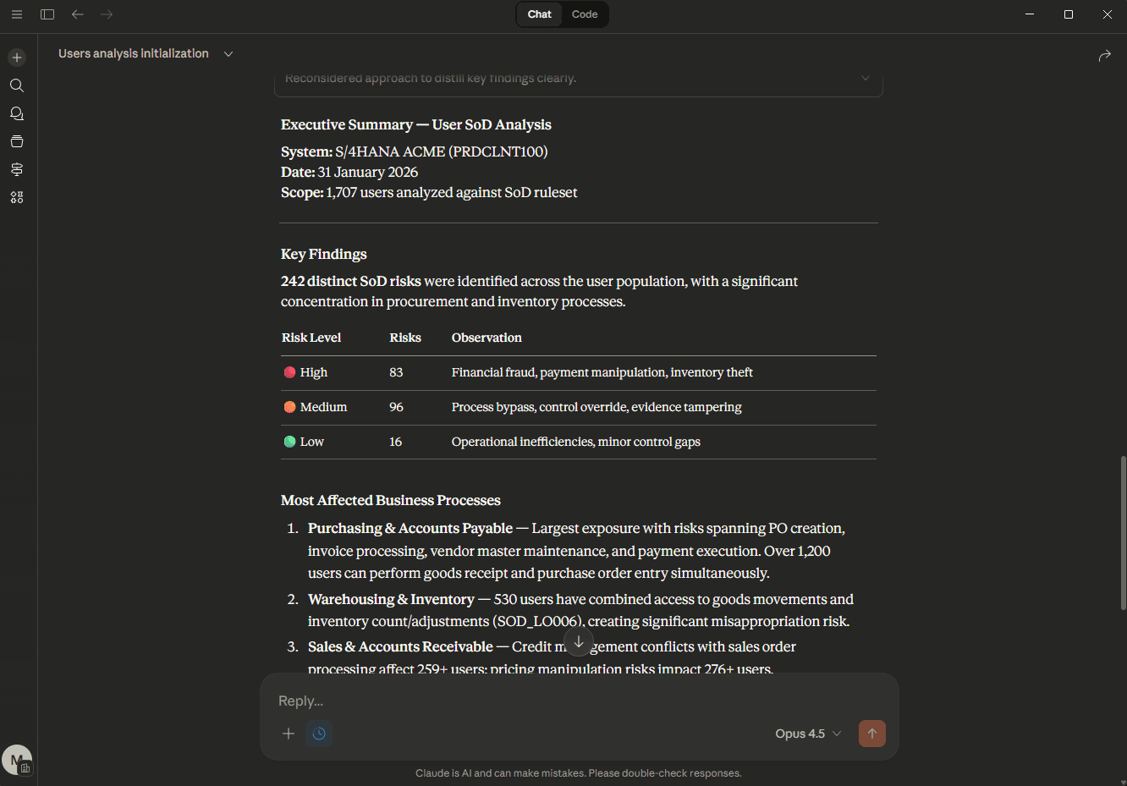
Built for the AI Era
Your data, structured for AI agents to reason about. MCP server connects your analysis directly to Claude, ChatGPT, or local LLMs.
Ask questions in plain English, get answers from your actual data. Zero cloud data exposure with local LLM support.
✓ MCP server for AI agent integration
✓ Works with Claude, ChatGPT, or local LLMs
✓ AI-optimized JSON/CSV exports
✓ AI Role Designer for SAP
Advanced Access Risk Analysis and Remediation for ERP Systems built for the AI era
Join forward-thinking companies using MTC Skopos for comprehensive access risk

Slide 9




Built for Compliance, Security & Audit Teams
Whether you're managing SoD compliance, security risks, or consulting, MTC Skopos adapts to your workflow
Compliance Team
Security Team
Security Consultants
Chief Information Officer
Manual audit processes taking weeks to complete
Unknown risks when making role changes
Slow analysis across multiple client systems
Fragmented risk visibility across IT landscape
✓ Automated SoD analysis completed in minutes
✓ Simulation shows impact before implementation
✓ Fast multi-system insights enhance efficiency
✓ Unified cross-system analysis and reporting
Streamline your Critical Access, SoD, and internal audit processes with automated risk detection.
Get clean and stay clean. Simulate the risk impact of authorization changes to roles.
Enhance your efficiency when conducting access risk analysis for clients.
Get faster, more versatile risk analysis across your entire IT landscape.
Advanced Access Risk Analysis and Remediation for ERP Systems built for the AI era
Join forward-thinking companies using MTC Skopos for comprehensive access risk

Slide 10
Why Not Traditional tool?
Traditional GRC tools were built for a different era. Here's how MTC Skopos compares.
Feature
MTC Skopos
SAP GRC / Traditional
Deployment
✓ Minutes (portable app)
✗ 3-6 months implementation
Infrastructure
✓ None required
✗ Servers, database, middleware
Data Sovereignty
✓ 100% local, never leaves your network
✗ Cloud or vendor-hosted
Analysis Speed
✓ Full system in minutes
✗ Hours to days
Analysis Type
✓ Did-do (actual execution)
✗ Can-do only (theoretical)
AI Integration
✓ Native MCP + local LLM support
✗ Limited or none
Cost Model
✓ Simple annual license
✗ Per-population + implementation + support
Advanced Access Risk Analysis and Remediation for ERP Systems built for the AI era
Join forward-thinking companies using MTC Skopos for comprehensive access risk

Slide 11
Ready to Secure
Your ERP Systems?
Join forward-thinking companies using MTC Skopos
for comprehensive access risk management.
Advanced Access Risk Analysis and Remediation for ERP Systems built for the AI era
mtcskopos.com • info@meylan-tc.com • Meylan Technologies & Consulting, Geneva
Join forward-thinking companies using MTC Skopos for comprehensive access risk

